Slide 1
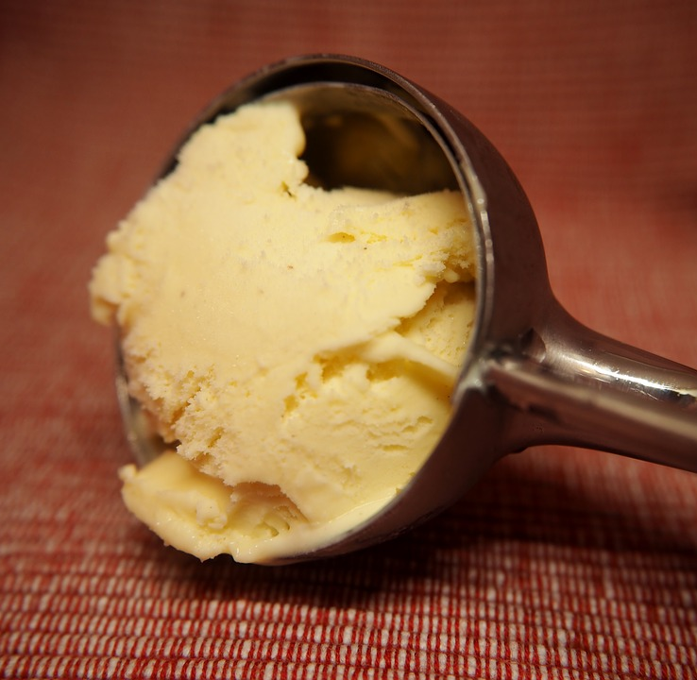
Quelle glace tu préfères?
Images: pixabay

Slide 2
Teacher instructions
Teach and practise 9 ice-creams as displayed on the next slide.
Stress the correct pronunciation of vanille (phonics!)
Provide each student with a written list of the ice-creams (with translations if needed – see the last slide. Alternatively (maybe better!), get the class to copy down the list on a piece of paper.
When you think the class is ready, tell students to mill around and ask their classmates which three ice-creams from a list they prefer.
Students then sit down and add up their scores.
Ask the class what they found, write up some scores on the board and decide what the three most popular fruits are. Nothing too scientific!
Four question forms exist – take your pick:
“Quelles glaces préfères-tu?” “Tu préfères quelles glaces?”
“Quelles glaces tu préfères?” “Quelles glaces est-ce que tu préfères?”

Slide 3
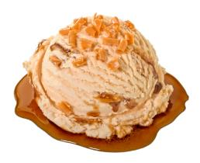
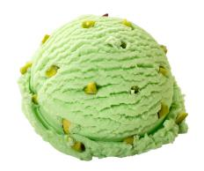
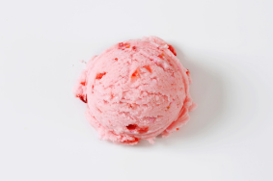
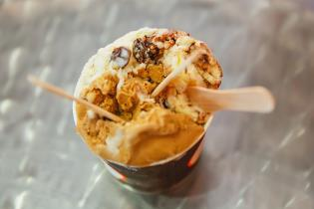
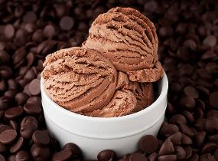
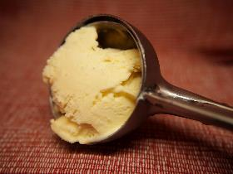
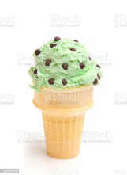
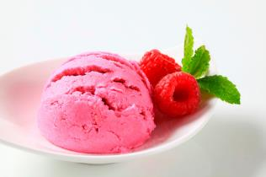
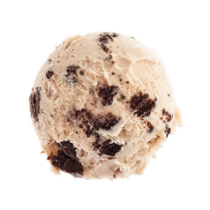
au caramel | à la pistache | à la fraise
rhum-raisin | au chocolat | à la vanille
à la menthe | à la framboise | aux cookies

Slide 4
Go around the class asking what THREE ice-creams from the list below your classmates prefer. Mark a tick in the box against each answer you hear. Add up the scores at the end.
rhum-raisin |  | à la framboise
à la vanille |  | à la pistache
au chocolat |  | à la menthe
au caramel |  | aux cookies
à la fraise

